Slide 1
Formula 1
Analysis
Thomas Ngo
Nick Rodio
Jeesu Kwon
Arman Bains
Zoe Bennett
Yvette Song
Notes:
Jeesu

Slide 2
Project Objective
Create an interactive web application describing formula 1 racing data over the past 75 years
Notes:
Jeesu

Slide 3
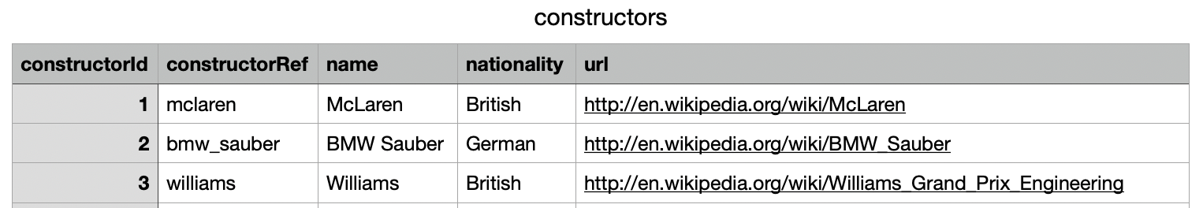
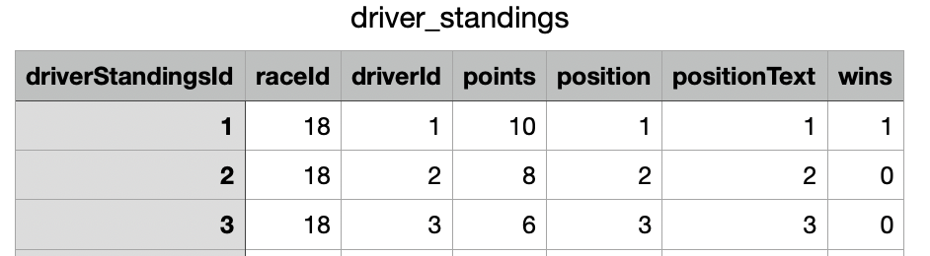
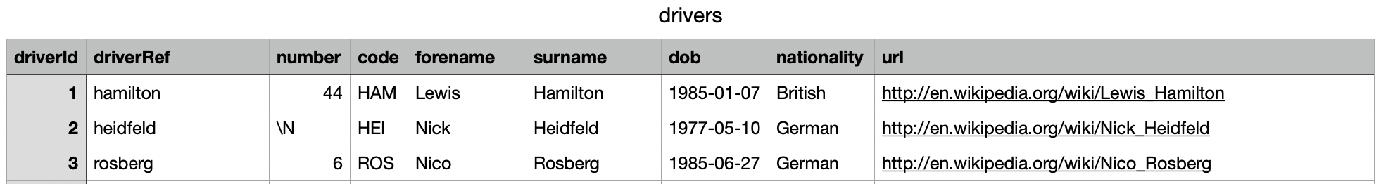
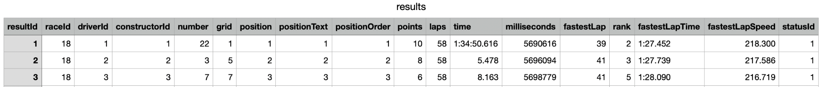
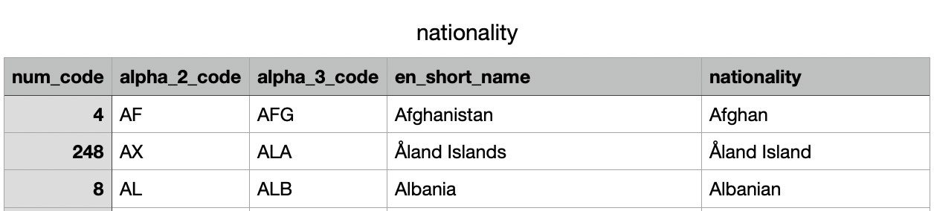
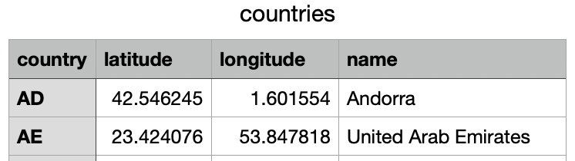
Original Dataset
13 csvs, 860 Drivers, 120 columns, 75 years, 26k results
constructors.csv
driver_standings.csv
drivers.csv
results.csv
races.csv
Source: Kaggle (Formula 1 Race Data)
Nationality.csv
countries.csv
Source: Google
Google
Kaggle
Notes:
Zoe

Slide 4
Data Processing
Update Nationality Names
Pull in Additional Datasets
Drop Unused Columns
Ex: ‘East German’ => ‘German’,
‘British, UK’ => ‘British’
Used public google csvs to match nationalities, country names and lat-long data
URLs, codes, dobs, positions, etc and combine first and last name cols
Find Career Wins
Merge Tables
Export
Trim results.cvs to winners only and count driver wins to create career_wins.csv
merge nationality/location data to drivers.csv
merge constructor/lap time data to car_dropdown.csv
Export final four csvs
Notes:
Zoe

Slide 5
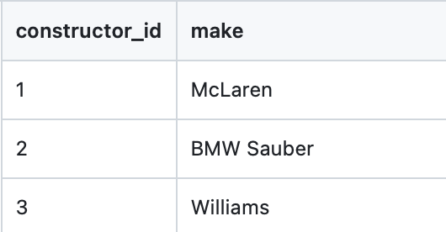
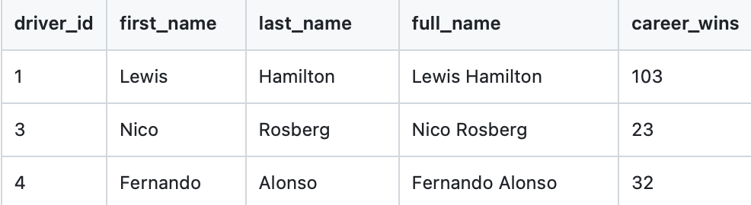
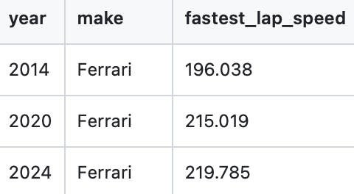
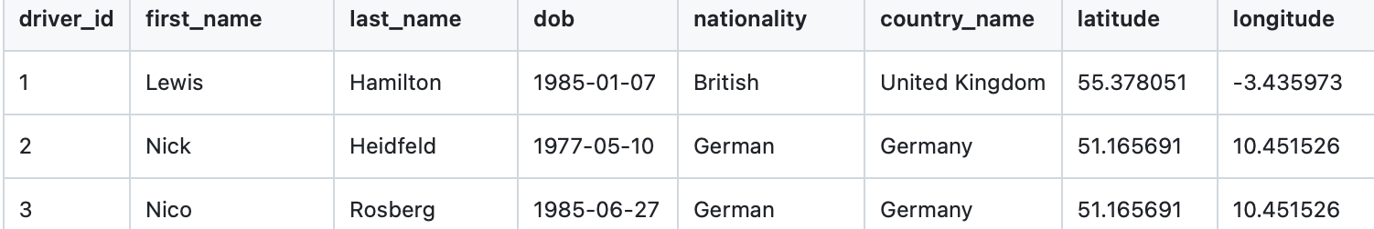
Final csvs
constructors.csv
career_wins.csv
Venus has a beautiful name, but it’s hot
car_dropdown.csv
drivers.csv
Notes:
Zoe

Slide 6
Next Steps
01
02
03
04
Populate Database
Create the Flask routes for the dashboard
Create HTML files
Create .js files for visualizations

Slide 7
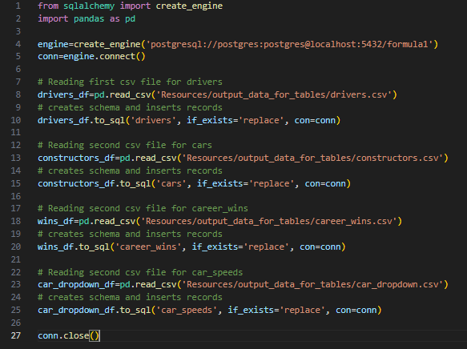
Population of Database
Populated our formula1 database in PostgreSQL with updated CSV files
Notes:
Nick

Slide 8
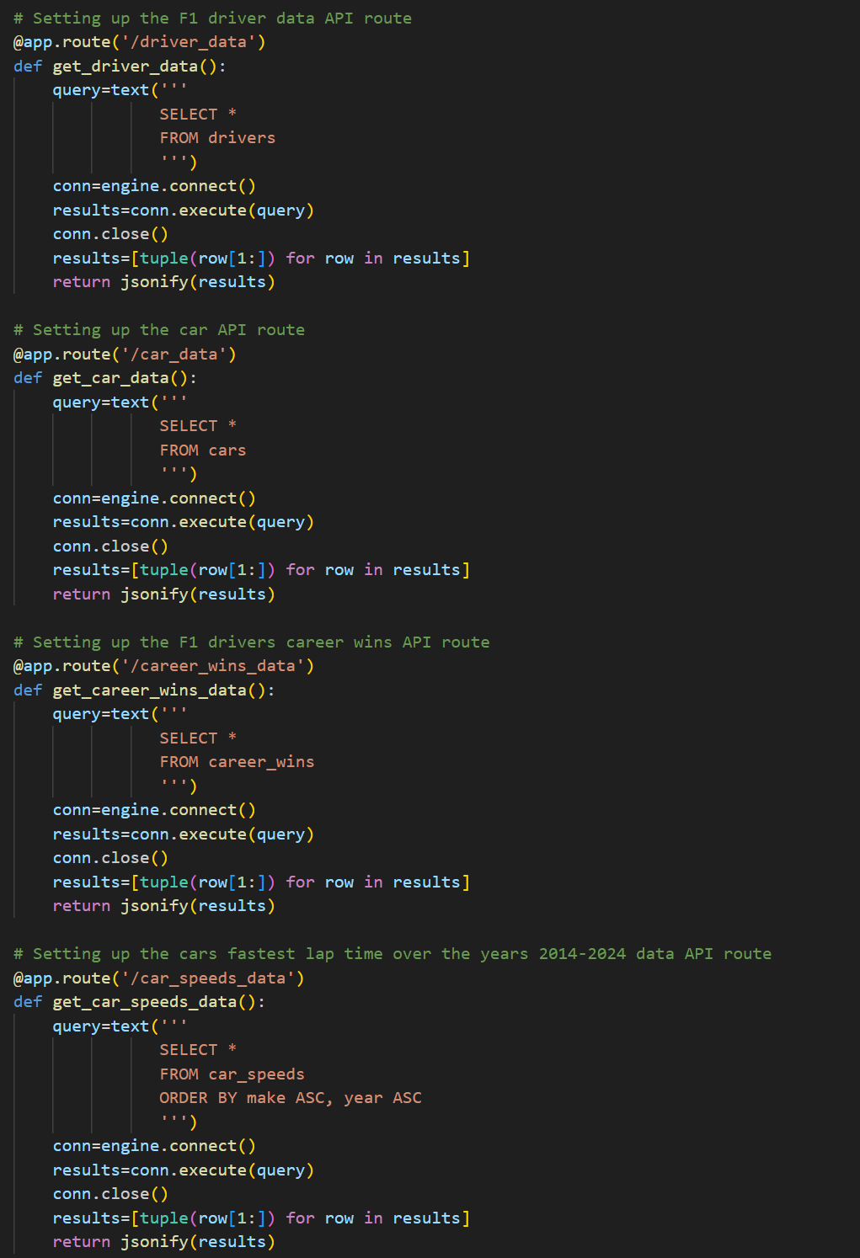
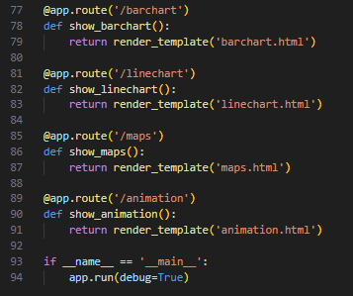
SQLAlchemy/
Flask
Defined our data/visualization routes
Used select * queries to retrieve information
Converted results into JSON format
Notes:
Nick

Slide 9
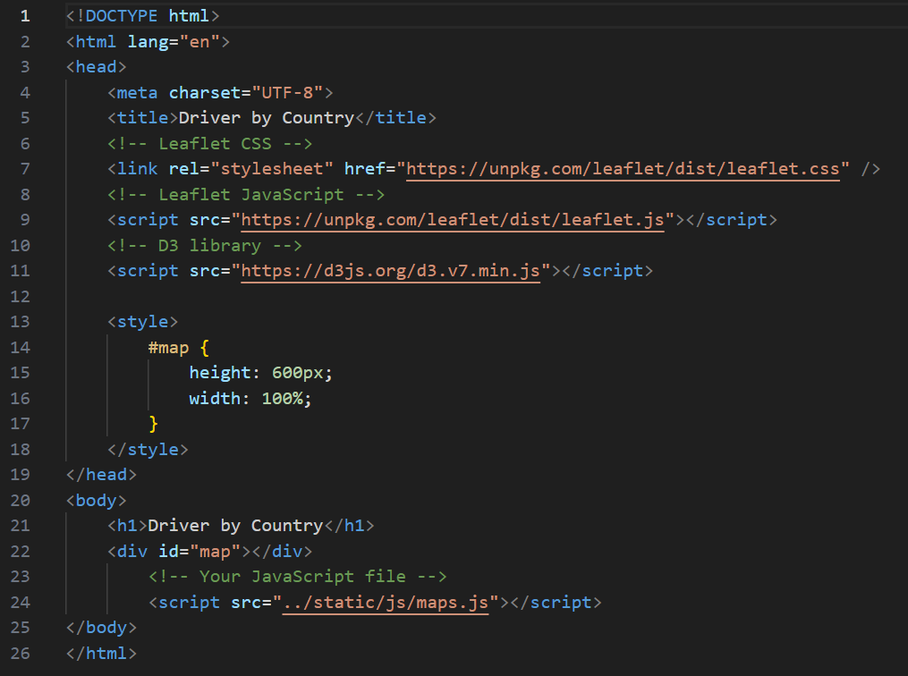
HTML
Multiple HTML files for each respective visualization
Each HTML holds the code for visualizations (bar, line, map, & animation)
Each HTML is rendered for their own route
Notes:
Nick

Slide 10
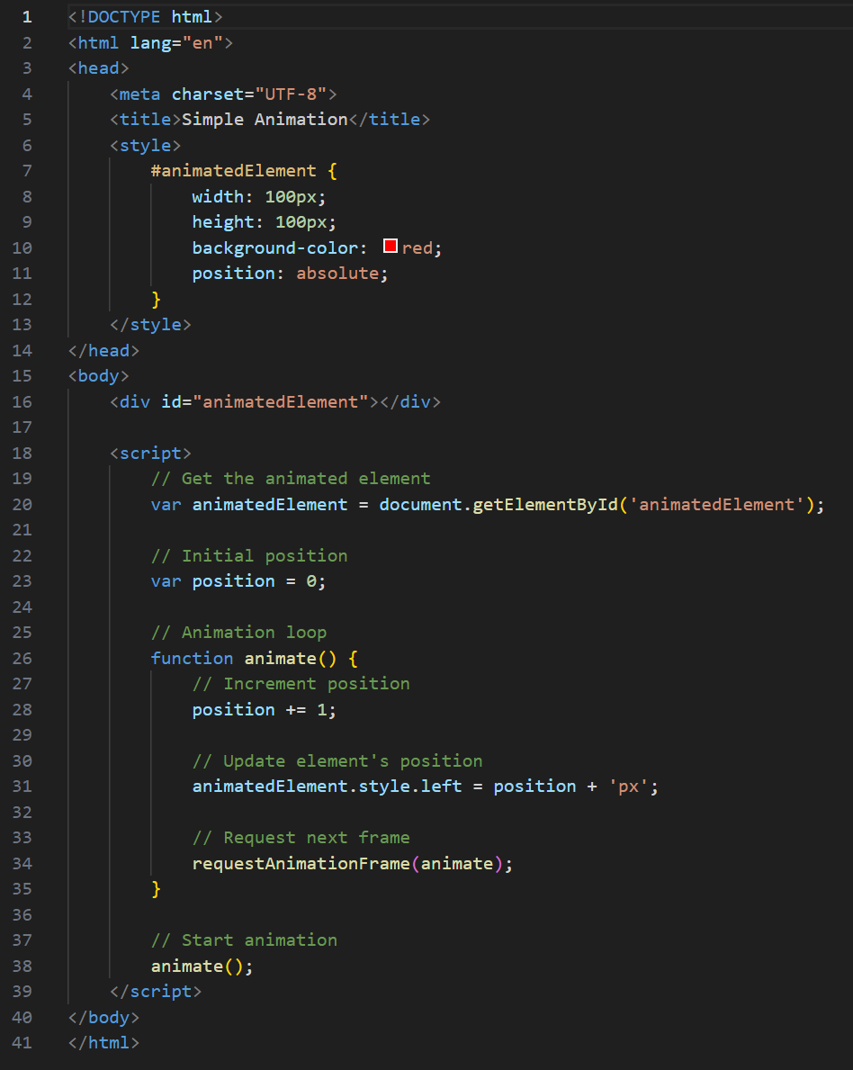
Animation
Created a div for an animated element
Initialize a variable position and increment it by 1 pixel each frame
Call the animate() function on the homepage
Notes:
Nick

Slide 11
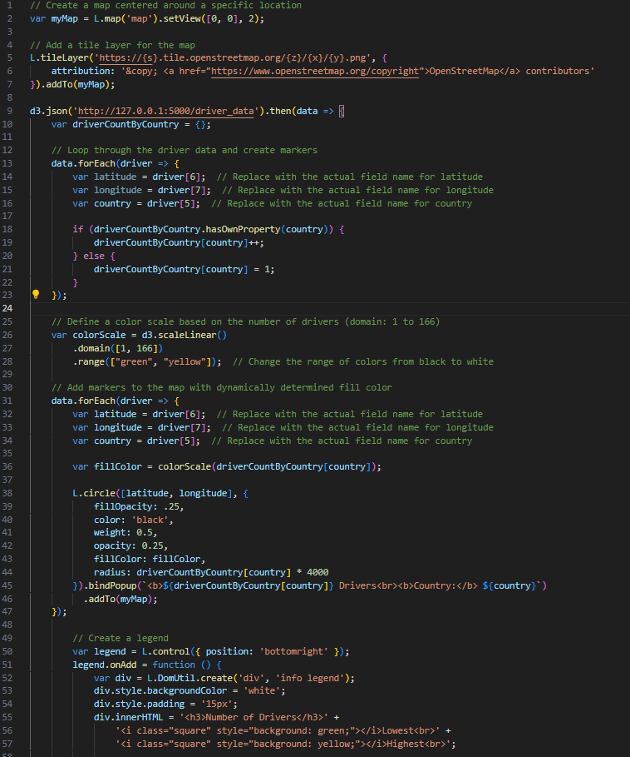
JavaScript
Created four .js files for each of the three visualizations & car animation
Each respective HTML file rendered the four .js files
Notes:
Nick

Slide 12
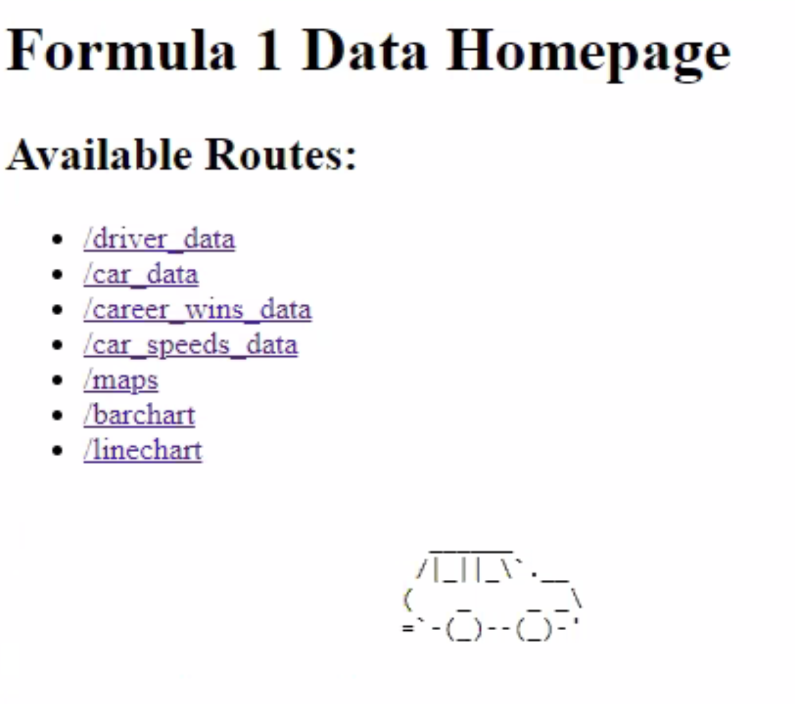
Web App Home
Use Flask to create homepage displaying API Routes and visualizations
ASCII Art car drives across the screen
Available Routes:
JSON Table Data (Routes 1-4)
Three visualizations (Routes 5-7)
Notes:
Nick

Slide 13
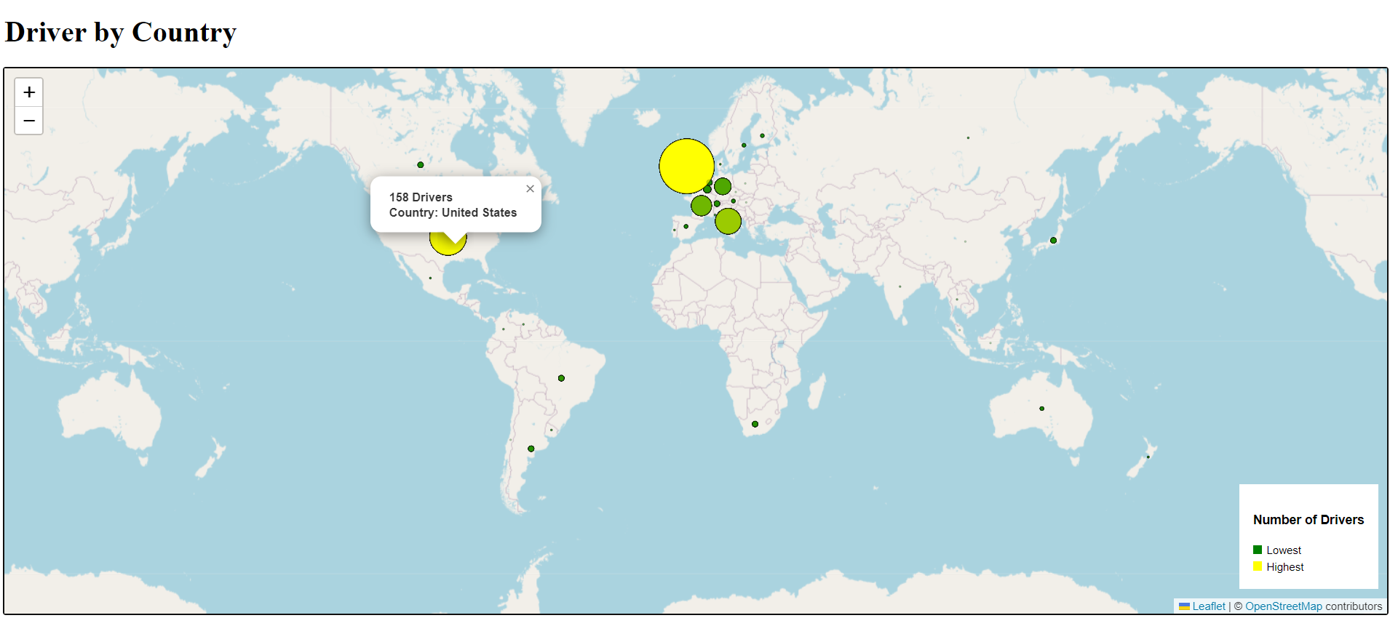
Visualization 1:
Map
Bubble Chart describing driver origin, how many drivers by country
Clickable pop up for driver number

Slide 14
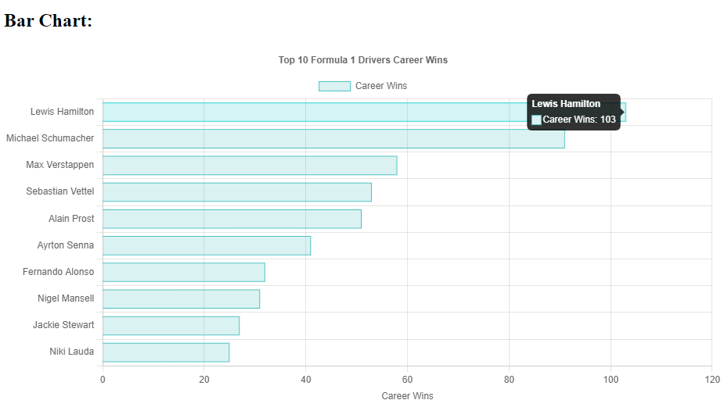
Visualization 2:
Bar Chart
Bar chart showing the top drivers by their career wins
Hover over for career wins

Slide 15
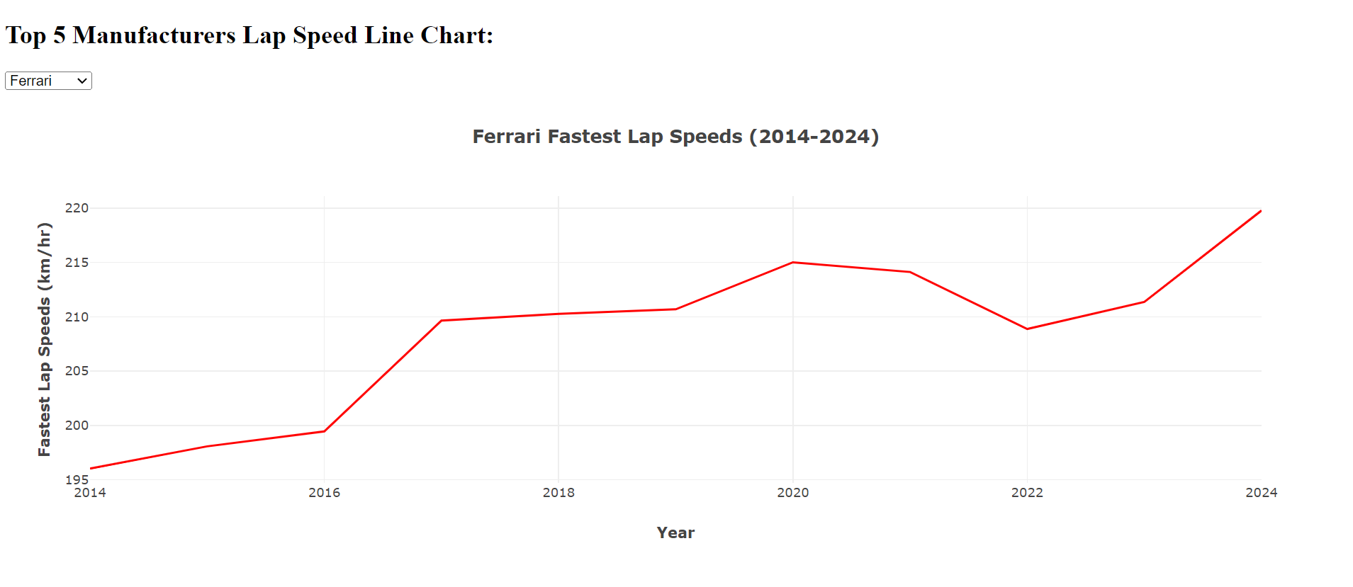
Visualization 3:
Line Chart
Line chart showing the last 10 years of data for the top five manufacturers’ fastest average lap speeds
Dropdown menu allows user to toggle between each of the top five automakers
Hover over for average lap speeds

Slide 16
Website Demo
Notes:
Thomas

Slide 17
Conclusion
Most successful drivers:
*** Mercedes drivers from the UK ***
Fastest Average Lap Speed % Increase (2014-2024)
Red Bull - 12.75%
Ferrari - 12%
Mclaren - 11.8%
Mercedes - 11%
Williams - 10.2%
Next steps:
Using a different visualization style for the driver origin map
Further standardizing the data for the manufacturer over time line chart

Slide 18
THANK YOU!

